Slide 1

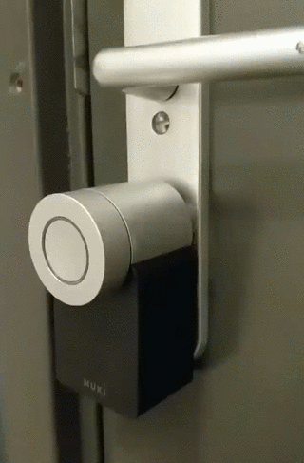
Everything is better with(out) Bluetooth
This presentation is available at https://docs.google.com/presentation/d/1lSReYeUx0t_KwUnmn1NX47ozq8uY5GoZ4xzz0IwlJ3s/

Slide 2

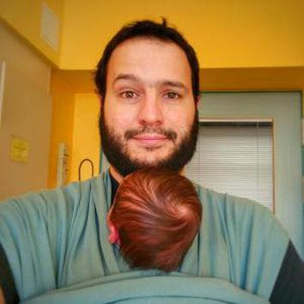
About us
Falko
Full stack tinkerer
Cargo Bike Pimper
Chief (technical) Product Manager at Sensorberg^{Android/iOS dev}
about.me/falkorichter @volkersfreunde
Ronaldo
Android Dev
Raspberry Pi enthusiast
Expert Diaper changer
github.com/budius | @ronaldopace

Slide 3

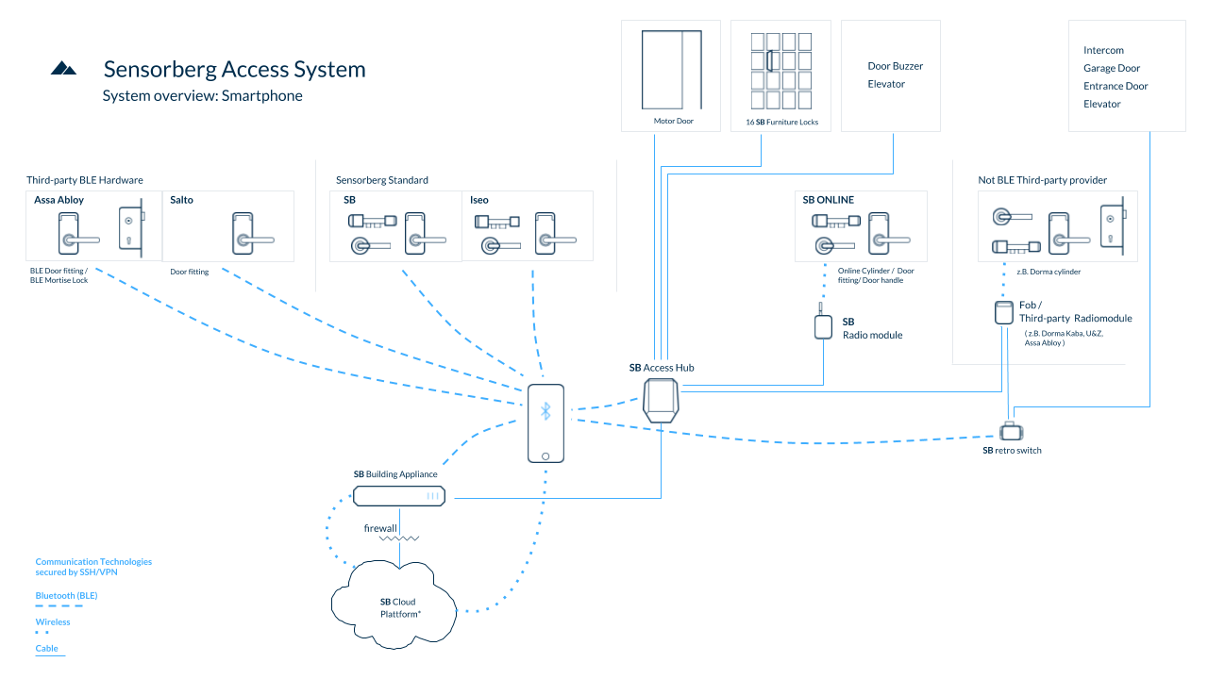
Project Overview
Sensorberg
Smart Spaces — where people and buildings interact
Getting into a space is the first interaction
Of course with your phone!
Bluetooth LE really is the only common denominator for a reliable connection
offline capable, fast, reliable*
Interactions currently:
book a meeting room
open a locker
open the entrance
open a garage
* let´s talk later about reliablity

Slide 4

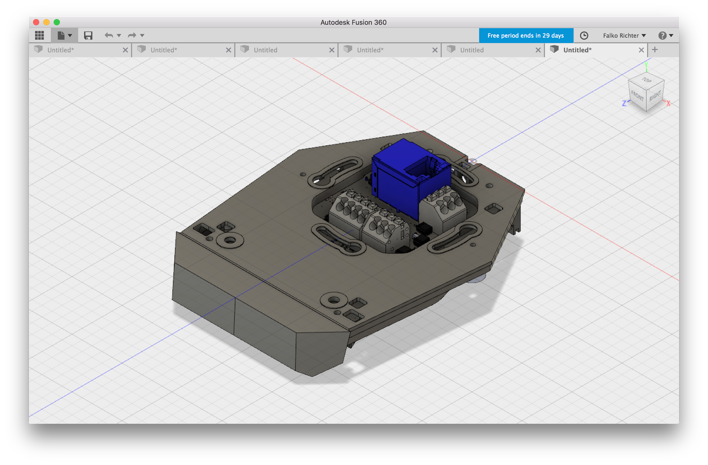
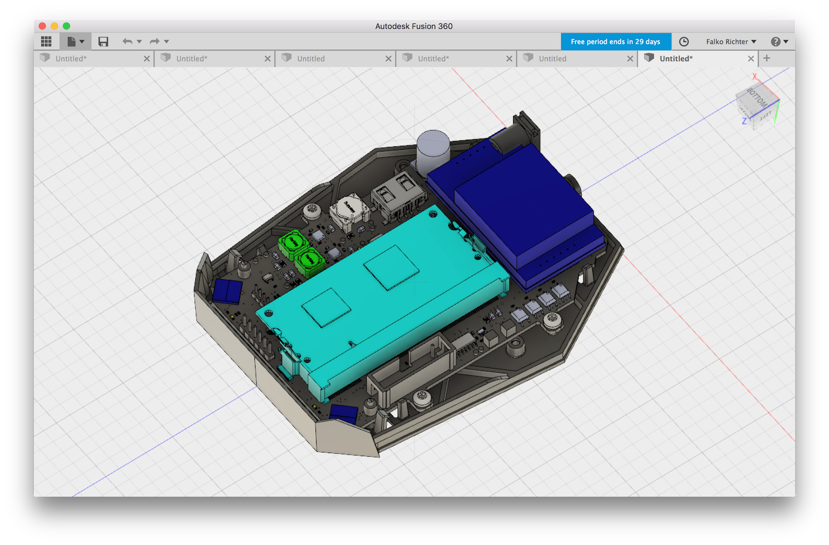
Project Overview
Device needed which has BLE, internet & can open door hardware
Pi compute Module Platform
Custom board 100% made in Berlin
All based on open source software & hardware

Slide 5
BLE - what you should know
GATT (The Generic Attributes (GATT) define a hierarchical data structure that is exposed to connected Bluetooth Low Energy (LE) devices)
Service
Group of Characteristics
Characteristic
Write/ Read /Subscribe
has a UUID
Descriptions availble on bluetooth.com
https://www.bluetooth.com/specifications/gatt
you can also make up your own!

Slide 6
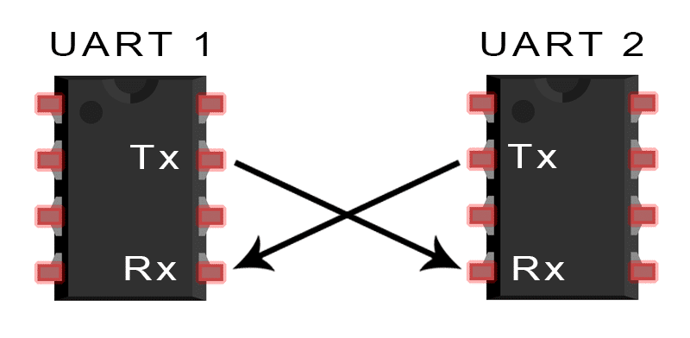
Project Overview - universal bluetooth communication
UART/Serial Port Emulation over BLE
open source / standard by nordic
https://learn.adafruit.com/introducing-adafruit-ble-bluetooth-low-energy-friend/uart-service
find (by Service)
connect
discover
subscribe to Rx
write to Tx Request
wait for answer on Rx Response
disconnect
https://infocenter.nordicsemi.com/index.jsp?topic=%2Fcom.nordic.infocenter.sdk5.v14.0.0%2Fble_sdk_app_nus_eval.html

Slide 7
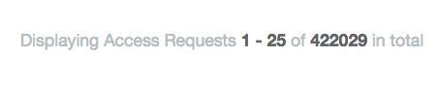
Challenge
Open a door/locker/garage as fast as possible
~ 0.5 million bluetooth connects (both platforms) add up to a lot of (potentially wasted) lifetime

Slide 8
How to Bluetooth-LE Scan
private val bleScanner = BluetoothAdapter.getDefaultAdapter().bluetoothLeScanner
override fun onStart() { super.onStart() bleScanner.startScan(callback) // optional scan filters and scan settings } override fun onStop() { bleScanner.stopScan(callback) super.onStop() }
private val callback = object : ScanCallback() { override fun onScanResult(callbackType: Int, result: ScanResult) { Log.d("MyApp", "onScanResult: $result. rssi: ${result.rssi} dB") } }

Slide 9
How to Bluetooth-LE GATT communication
if (isRightDevice(result)) result.device.connectGatt(context, false, gattCallback)
private val gattCallback = object : BluetoothGattCallback() { override fun onConnectionStateChange(gatt: BluetoothGatt, status: Int, newState: Int) { if (isConnected(status, newState)) gatt.discoverServices() else gatt.close() }
override fun onServicesDiscovered(gatt: BluetoothGatt, status: Int) { val gattCharacteristic = gatt.getService(serviceUuid).getCharacteristic(characteristicWrite) gattCharacteristic.value = "open door" gatt.writeCharacteristic(gattCharacteristic) }
override fun onCharacteristicWrite(gatt: BluetoothGatt, characteristic: BluetoothGattCharacteristic, status: Int) { val gattCharacteristic = gatt.getService(serviceUuid).getCharacteristic(characteristicRead) gatt.readCharacteristic(gattCharacteristic) }
override fun onCharacteristicRead(gatt: BluetoothGatt, characteristic: BluetoothGattCharacteristic, status: Int) { if(characteristic.value == "door opened") { /* success !!! */ } gatt.disconnect() } }

Slide 10
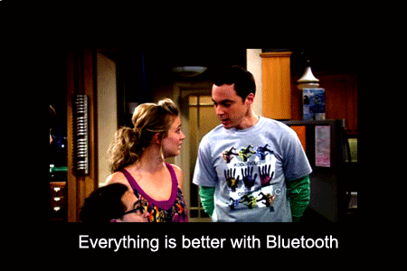
(OUT)

Slide 11
Everything is better with(out) Bluetooth
… scanning
BluetoothAdapter.getDefaultAdapter().startLeScan(scanCallbackV18)
Some devices doesn’t support certain scan settings parameters
Some devices doesn’t support scan filters
Some devices say they support scan filters, but result on callback never called
Workaround:
Use Nordic Scanner compat https://github.com/NordicSemiconductor/Android-Scanner-Compat-Library
// disable hardware filtering .setUseHardwareFilteringIfSupported(false)

Slide 12
Everything is better with(out) Bluetooth
… scan callback
override fun onScanResult(callbackType: Int, result: ScanResult) {
On some devices is called for every scan
on others, only on the first time a BLE device is scanned
Workaround is to startScan/stopScan every second
Starting on Android Nougat Developer Preview 4 > We’ve changed the BLE Scanning behavior starting in DP4. We’ll prevent applications from starting and stopping scans more than 5 times in 30 seconds. For long running scans, we’ll convert them into opportunistic scans.
Sources:
https://web.archive.org/web/20160820074825/https://developer.android.com/preview/support.html#dp4
https://android-review.googlesource.com/c/platform/packages/apps/Bluetooth/+/215844/15/src/com/android/bluetooth/gatt/AppScanStats.java#144

Slide 13

Everything is better with(out) Bluetooth
… scan callback
override fun onScanFailed(errorCode: Int) { // SCAN_FAILED_APPLICATION_REGISTRATION_FAILED // SCAN_FAILED_INTERNAL_ERROR }
Workaround:

Slide 14
Everything is better with(out) Bluetooth
… scan callback
private val scanCallback = object : ScanCallback() { override fun onScanResult(callbackType: Int, result: ScanResult) { scanResults[result.device.address] = result private fun openClosest() { val scanList = scanResults.values.filter { it.rssi >= threshold }.sortedBy { it.rssi } open(scanList[0]) }
rssi variance
time dependent weighted moving average https://github.com/sensorberg-dev/motionless-average
on device learning of threshold variance
start with a permissive default
adjust with a moving average of the rssi during successful connection
offset a few decibels for actual filtering

Slide 15
Everything is better with(out) Bluetooth
… GATT communication
`result.device.connectGatt(...)` only works if called from UI-thread
on some devices
override fun onConnectionStateChange(gatt: BluetoothGatt, status: Int, newState: Int) { if (newState != BluetoothGatt.STATE_CONNECTED) // connect again
override fun onCharacteristicWrite(gatt: BluetoothGatt, characteristic: BluetoothGattCharacteristic, status: Int) { override fun onCharacteristicRead(gatt: BluetoothGatt, characteristic: BluetoothGattCharacteristic, status: Int) {
if(status != GATT_SUCCESS) // retry
if (status == 133)
Source code: #define GATT_ERROR 0x0085

Slide 16
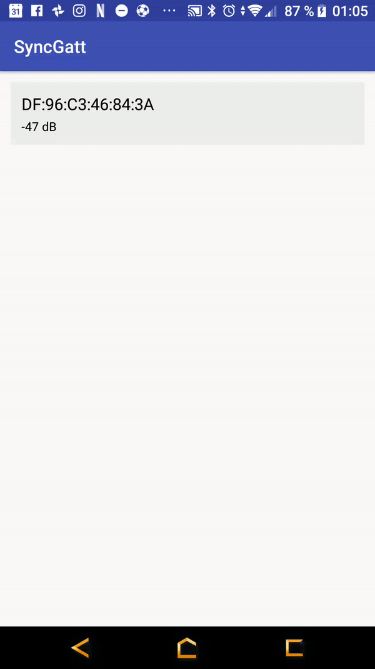

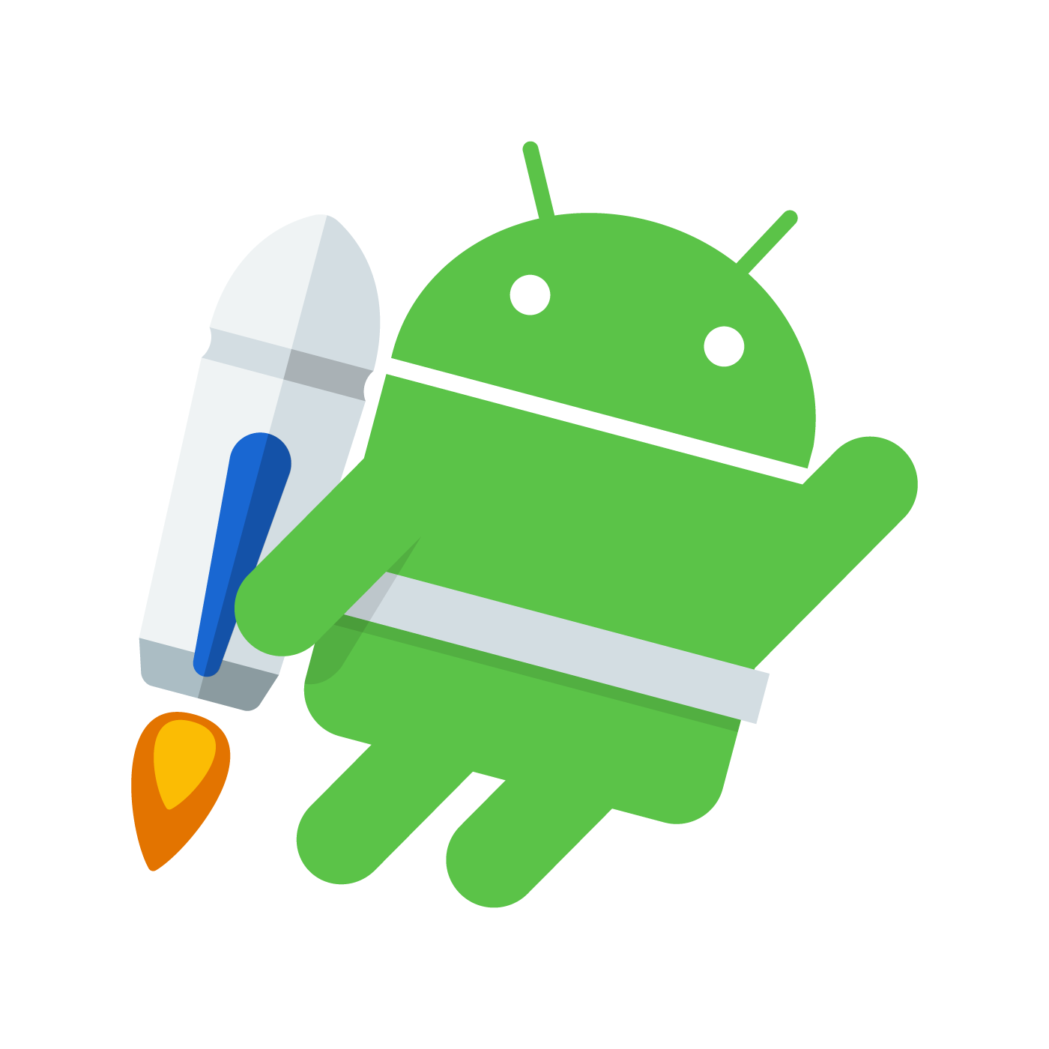
Everything is better with(out) Bluetooth
… GATT communication
Asynchronous callback based API
Thread { SynchronousGatt(scanResult.device).apply { connectGatt(this@MainActivity, false, 10000) discoverServices(3000)
val notify = bluetoothGatt.getService(serviceUuid) .getCharacteristic(characteristicRead).getDescriptor(descriptorNotify) notify.value = enableNotify writeDescriptor(notify, 3000) val writeCharacteristic = bluetoothGatt .getService(serviceUuid).getCharacteristic(characteristicWrite) writeCharacteristic.setValue("open door") writeCharacteristic(writeCharacteristic, 3000) val changed = awaitCharacteristicChange(5000) if (changed.characteristic.getStringValue(0) == "door opened") sucess() disconnect(1000) } }.start()
connect
discover
subscribe
write (x N)
await

Slide 17
Everything is better with(out) Bluetooth
… after much hacking
Scanning:
NordicScannerCompat
ScannerStartStop
ScannerNougat
Averaging algorithms
Did you try turn off and on again?
Communicating:
Synchronous API
Retry on random fail
Retry on random disconnection
Did you try turn off and on again?

Slide 18
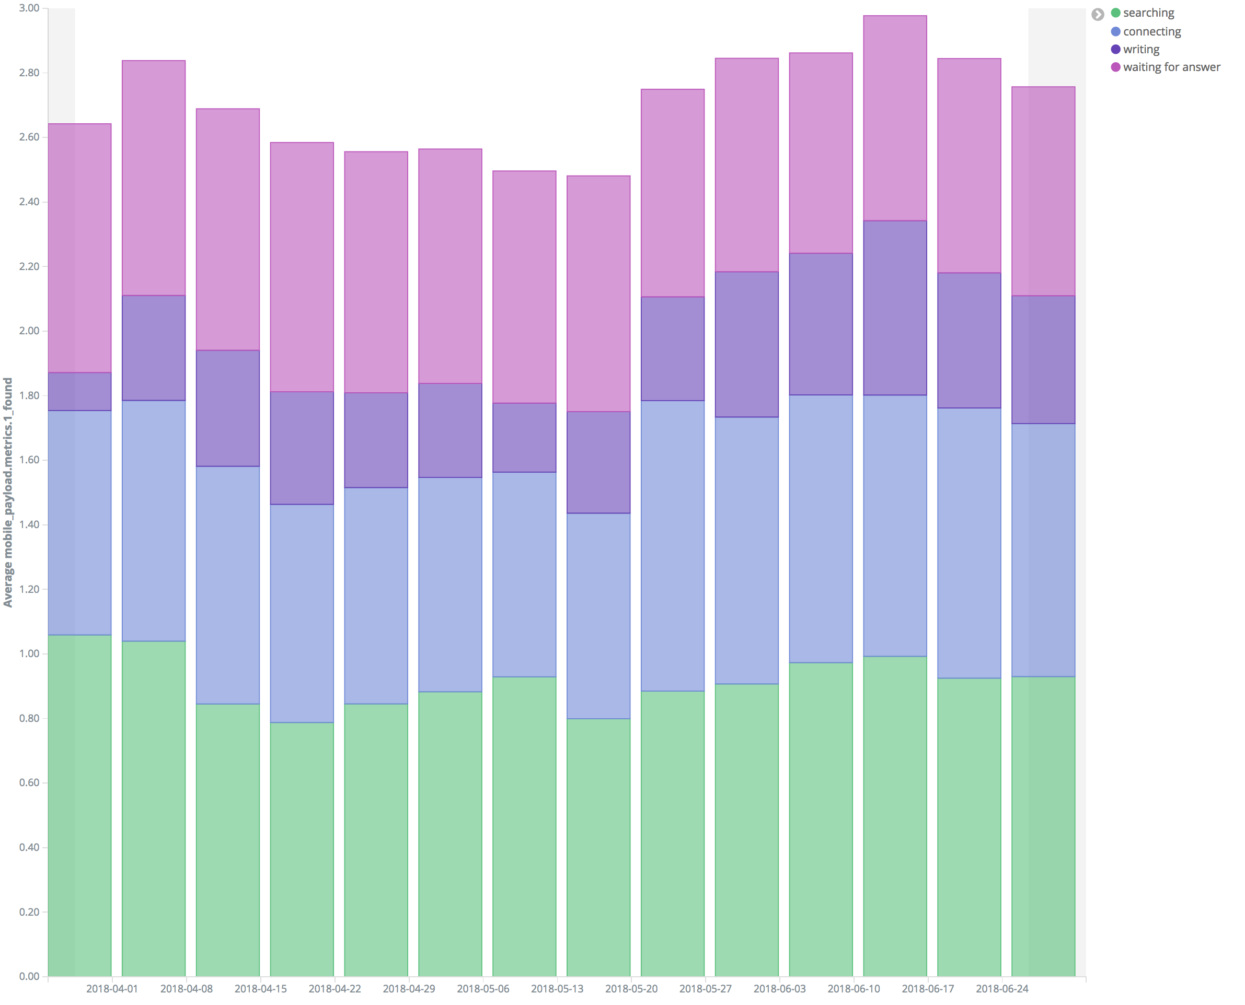
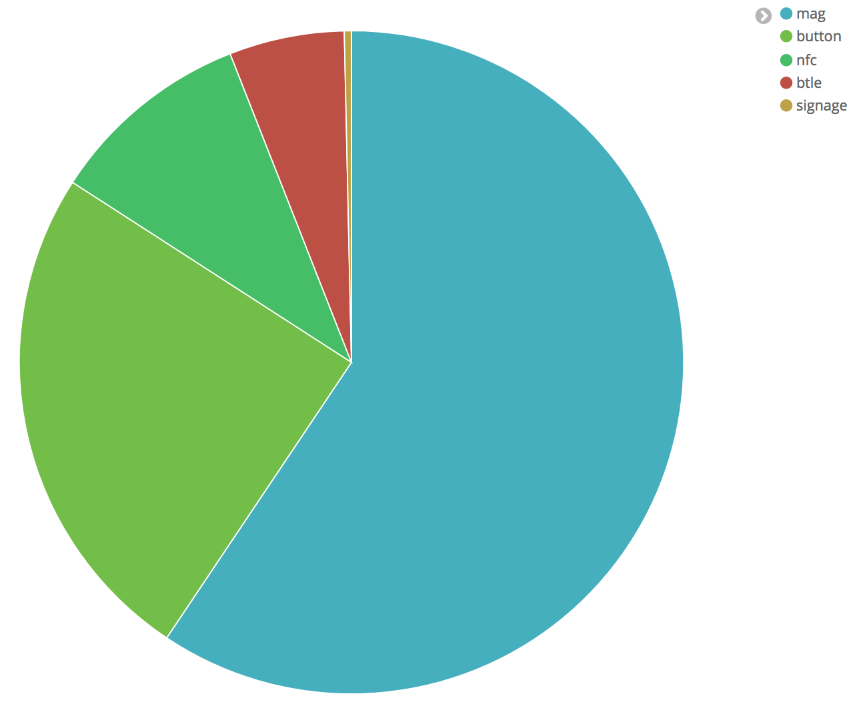
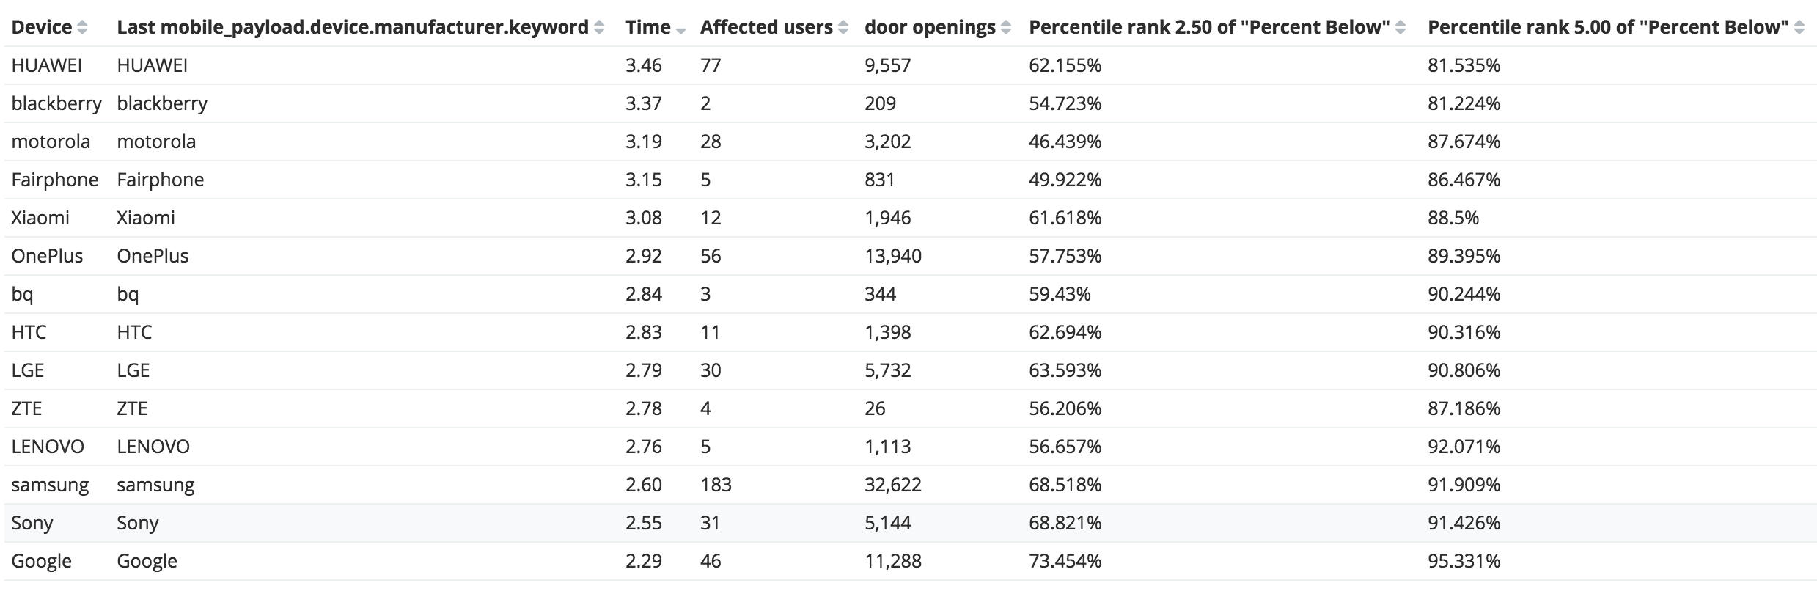
Data
~⅓ time is wasted trying to find the right device
Google is the best manufacturer (74% of access requests under 2.5s)
manufacturers ordered by average opening time
at least 2 users

Slide 19
Data
@POST("/") @Headers("Content-Type: application/json") Call<String> pushStatistics(@Body Stats stats);
Firebase is not enough
not realtime
no filtering
aggregations are to limited
Elasticsearch to the rescue
account: 2 minutes https://www.elastic.co/cloud/elasticsearch-service/signup
post JSON to your [...].aws.cloud.es.io:9243/{index}/mobile_statistics
simple rules for data integrity
never change a type (String becomes Number, String becomes Object)
lower case all strings / remove spaces
add UUIDs/hashes so you can count devices / users
one index per deployment (production / staging)
leave out personal data
delete indexes (buckets) regularly

Slide 20
Data
hack some visualizations in Kibana
combine visualizations to powerful interactive dashboards
metrics to find fragmented devices:
BuildConfig.VERSION_CODE
BuildConfig.VERSION_NAME
BuildConfig.APPLICATION_ID
Build.VERSION.SDK_INT
Build.MODEL
Build.MANUFACTURER

Slide 21
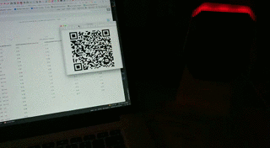
… how to avoid bluetooth
Hybrid detection and communication
Detection
Bluetooth (“This BTLE device is so close, I should connect to it”)
NFC (nfc://connect/to/DF:96:C3:46:84:3A)
Optical?!
(magnetic) tap detection
communication (try all, winner takes it all)
Bluetooth
HTTPS via wifi/cellular
NFC (in the next generation of the hardware)
synchronize with a request ID in backend or on access hub

Slide 22


Testing
LEGO train #ftw
get the (not sold anymore) powered tracks (no battery)
use two power modules for reliability - it will make the train go reliably slow!
Schwerlastzug 60098 is great
You need to physically test it!
real devices
actual Bluetooth hardware
use your statistics to verify the performance
Long term testing
Parameters
speed
distance to device
additional sensor to detect phone position
power the train from the access hub => full control

Slide 23
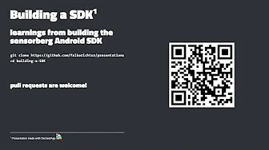
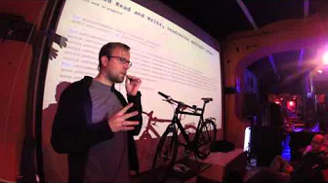
Thx & Sensorberg Open Source:
https://github.com/sensorberg-dev/permission-bitte
https://github.com/sensorberg-dev/motionless-average
https://github.com/sensorberg-dev/EasyIPC
https://github.com/sensorberg-dev/gradle-scripts
https://github.com/sensorberg-dev/android-sdk
soon: https://github.com/sensorberg-dev/synchronous-gatt
We will of course make an SDK from this as well https://www.youtube.com/watch?v=rLuBxsLot5U
Another Bluetooth related GDG talk^{by Falko} https://www.youtube.com/watch?v=OSJ8gIPnvDw

